Slide 1
Calibration Pipeline
Environment = mcSIM_Dev_try

Slide 2
Calibration Step 1
Use highlighter slide!
upload calibration mask ->
users/researcher/3DFAST-main/3DFAST-main -> upload_DMD_calibration.py
take photo with FULL Frame in ArenaView (should see dots!), re-upload if not (may need to add gain)
save photo in users/researcher/mcSIM/examples/data

Slide 3
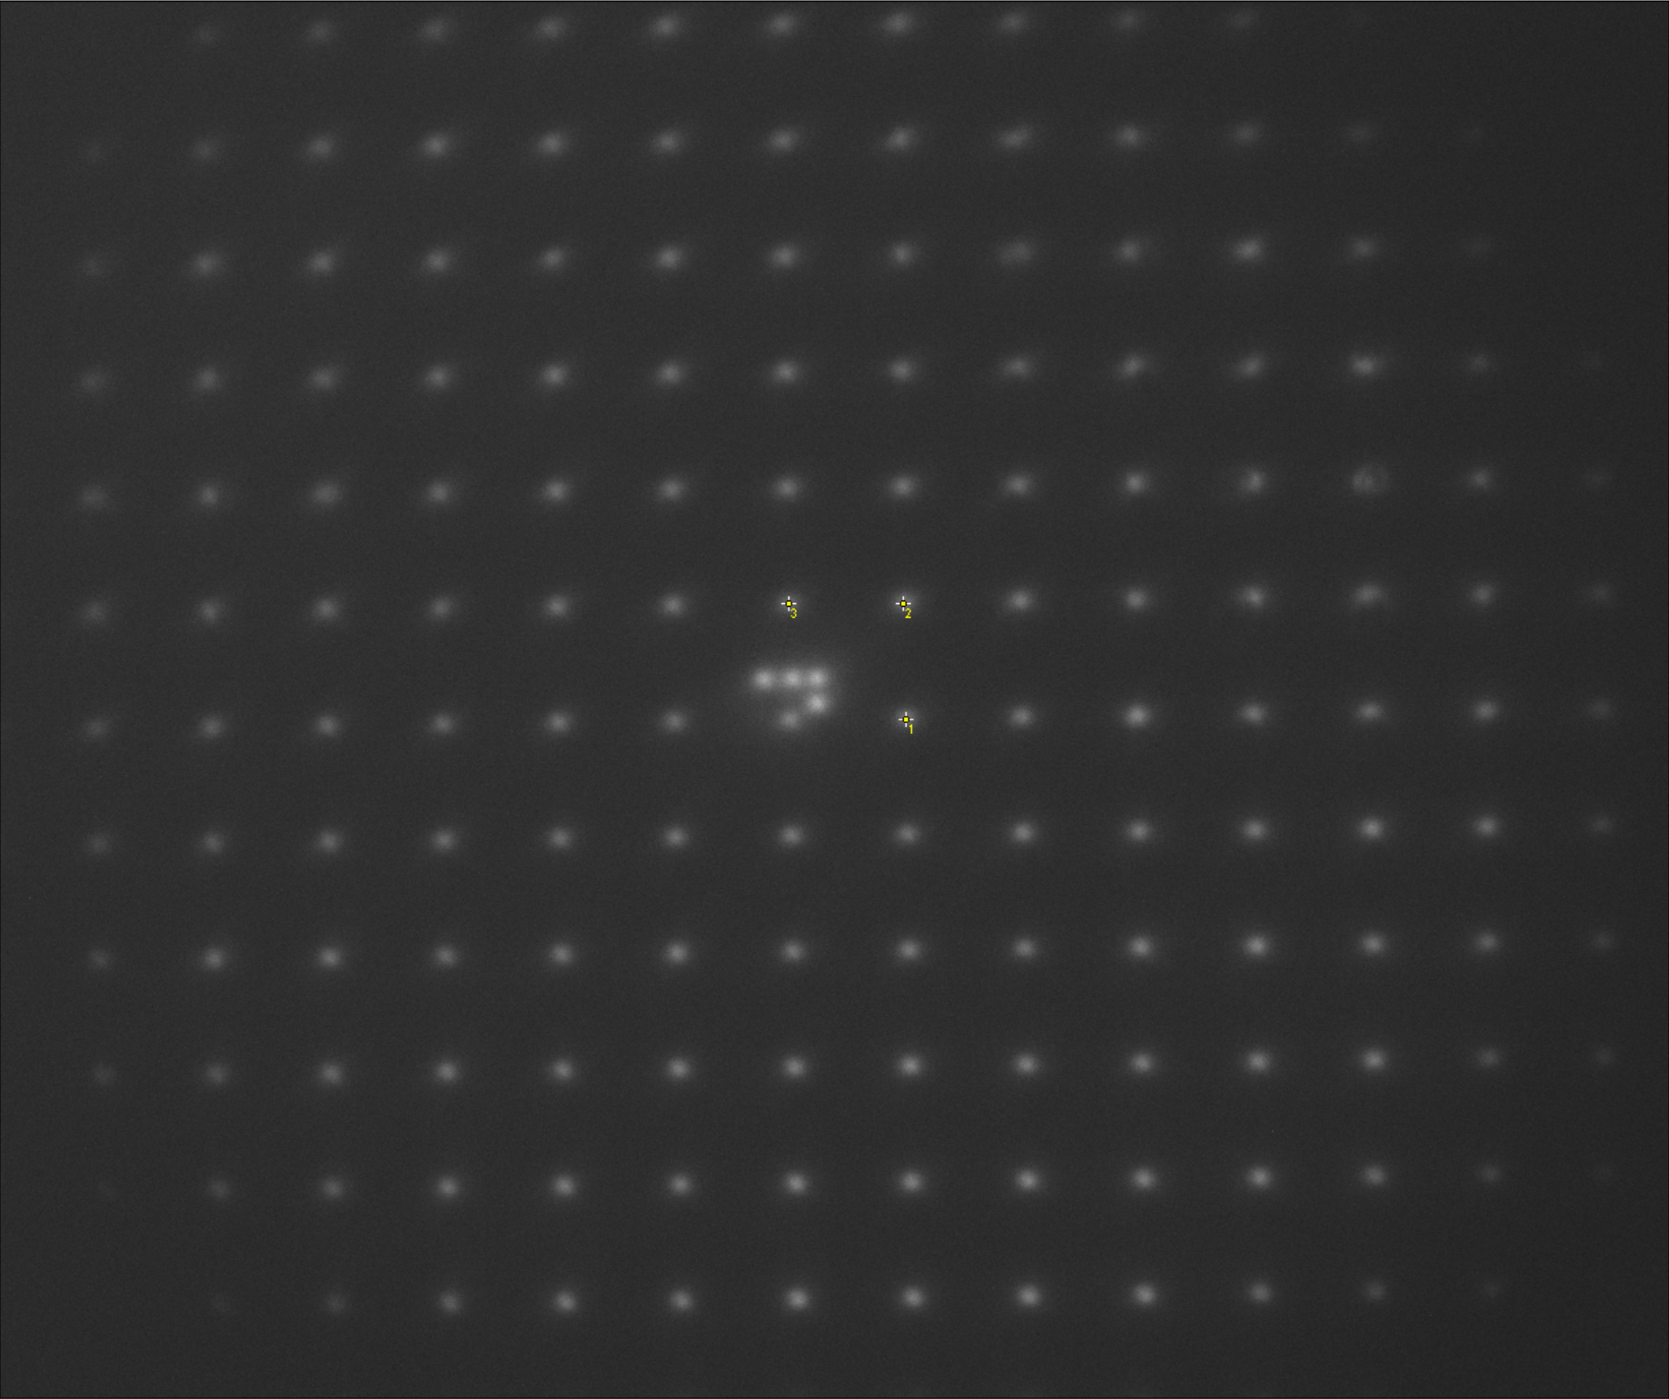
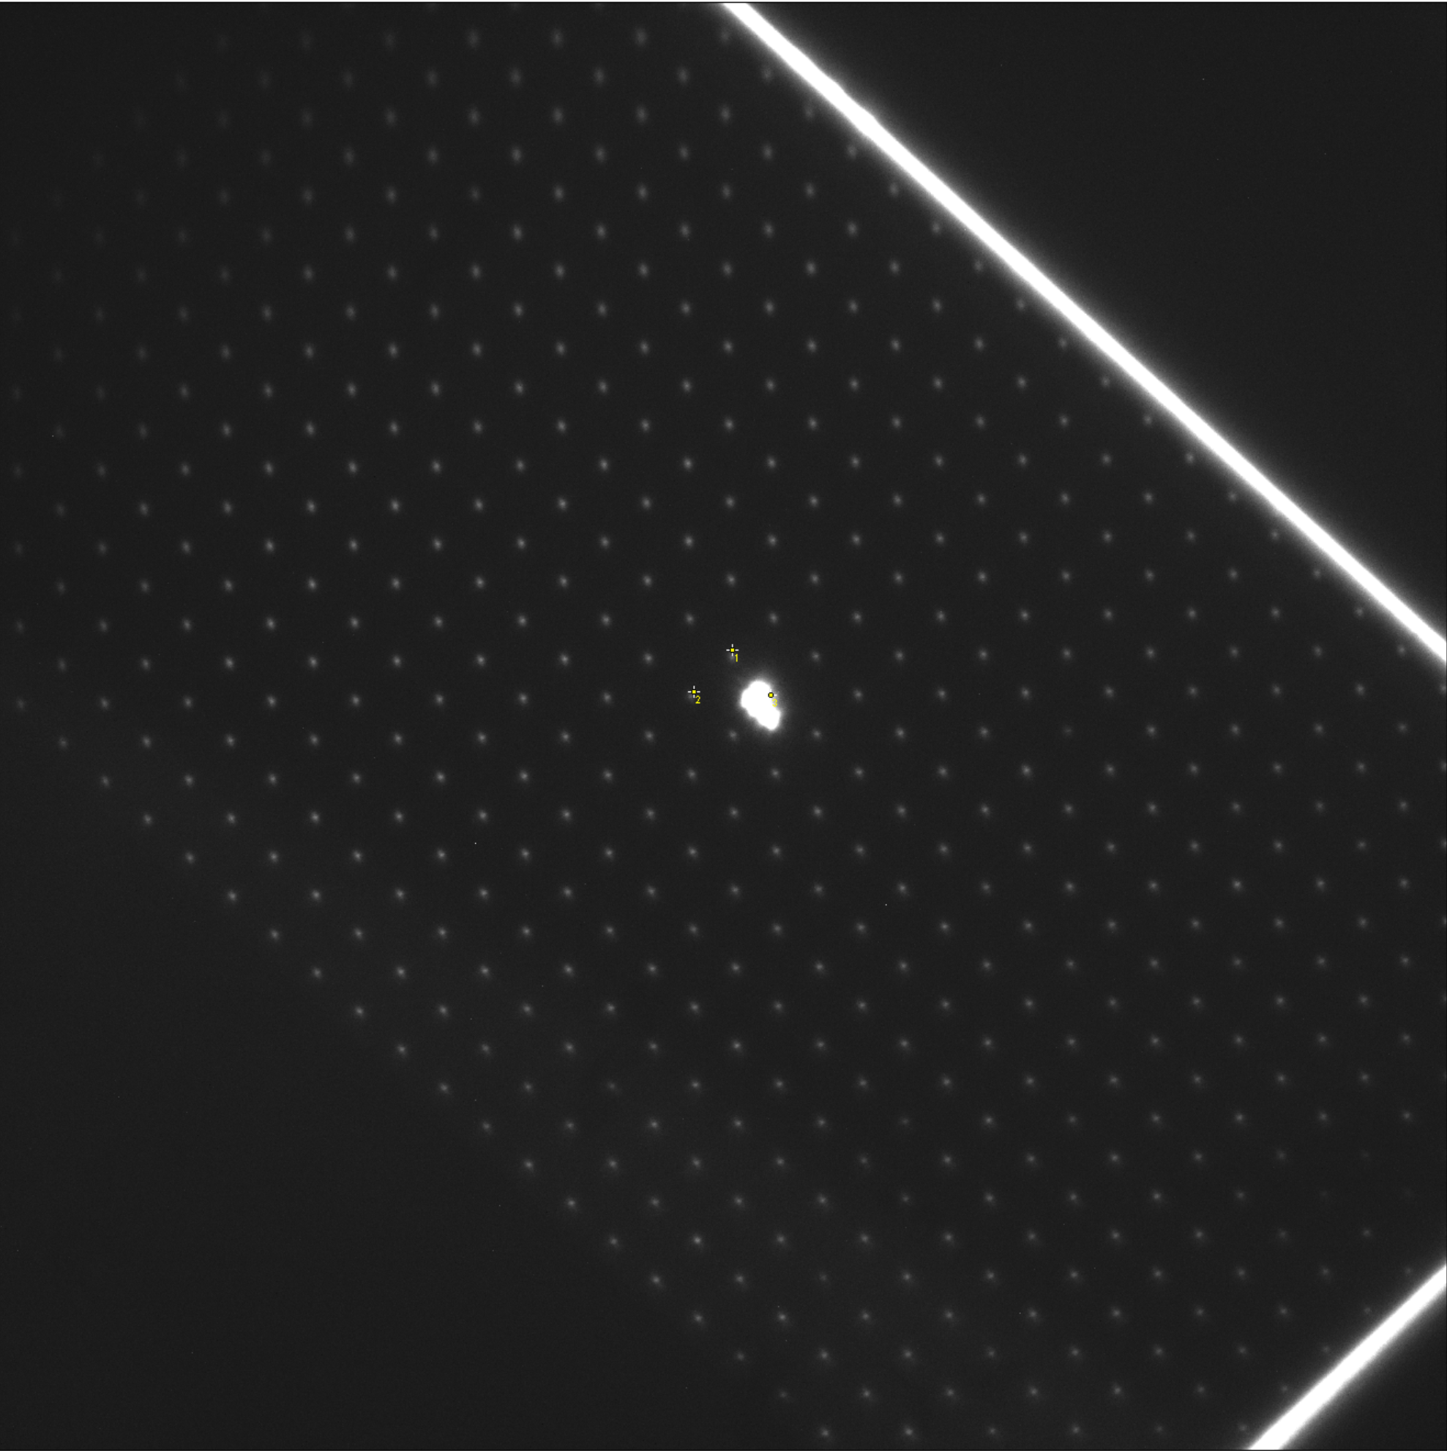
Calibration Step 2
Open Affine xform script
users/researcher/mcSIM/examples -> calibrate_affine_xform_ATLAS10.py
Change lines for image_fname to photo from earlier (30?)
Update centers_init values:
in Fiji:
-open photo from step 1 as well as McSIM/examples/Data -> calibration_dot_indices.png !
-find center of 6 each dots in the new photo that are labeled 1-6 in the calibration photo
-update values for centers_init with these center points -> MUST BE IN CORRECT ORDER OF DOT CALIBRATION PHOTO!!! Y/X REVERSED! (not sure which one of these it is [above])
run calilbrate_affine_xform_ATLAS10.py

Slide 4
Calibration Step 3
Switch to real Sample!
Open users/researcher/mcSIM/examples/convert_ATLAS10_to_DMD.py
Switch save_dir variable to folder created in step 2
Use ArenaView GUi to take photo of full sample FOV, save in users/researcher/mcSIM/examples
Update draw_reactangle_with_drag and test_path values to the name used with the full FOV frame just taken
Run convert_ATLAS10_to_DMD.py
Draw box around target in CV2 GUI that pops up.
Watch selective target illumination in ArenaView
Change ArenaView parameters and record.. or whatever !!!

